Slide 1
Quora Insincere Questions Classification
Group 17 - Hardly Humans
Name | Enrollment Number
Sanya Zaveri | AU1920064
Mihir Pathak | AU1920138
Parth Shah | AU1940065
Malav Doshi | AU1940017

Slide 2
Introduction
Quora is a website where a community of users can ask and answer questions.
Some of the characteristics that can signify that question might be insincere are:
Consists of a non-neutral tone
Question is disparaging or inflammatory.
Question is not grounded in reality

Slide 3
Problem statement
As being in top 10 most visited social networks in the world, censoring the content of questions is also an extremely important factor to make the value of this social network.
This problem focus on determining whether a question asked on Quora is insincere or not. The input is a text string and the output is 0 (sincere) or 1 (insincere).
It is a binary classification problem.

Slide 4
Related Work
There have been many contributions in the domain of text classification. It is due to the business value it adds by classifying text on the basis of various parameters.
Another such paper proposed a model for classifying tweets. The author had implemented a Logistic Regression model of machine learning for classifying tweets according to their the topic they belong. The system transformed the tweets into vector which is acceptable by the model. The confusion matrix showed an accuracy of around 92%.
This system uses just one algorithm which does not give any evidence that this model has performed the best. The proposed system will implement 4 models which will enable to analyze which is performing better.

Slide 5
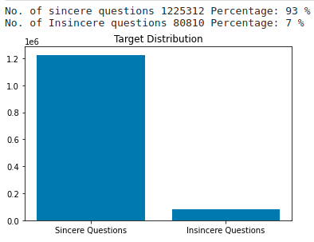
Data analysis
The dataset is from Kaggle competition of Quora Insincere Questions Classification.
On visualising the given training set on a bar graph (Figure. 1), we observe the data has 1.3 million entries, in which 93% of entries are sincere questions, while the rest questions are insincere questions.
Figure 1

Slide 6
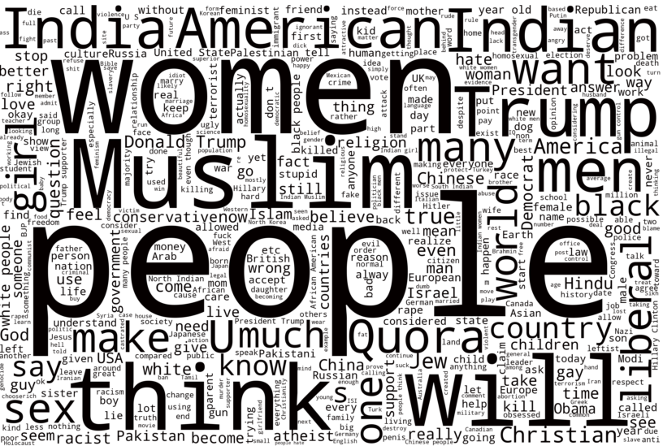

We visualize of questions in form of WordCloud for observing words with common occurrences.
In WordCloud of Insincere Questions, we observe words such as India and Indian, which have essentially the same root, hence we need to apply lemmatization in our training set.
Similarly in WordCloud of Sincere Questions, , we observe the words such as will to be the most common word with highest occurrences which is insignificant to our classification problem, hence we need to remove Stop Words to only consider relevant words.
Insincere Questions WordCloud
Sincere Questions WordCLoud

Slide 7
Data pre-processing
Stopwords
What are they => words which does not add much meaning to a sentence(eg: a, the, is, are).
Why to remove them => remove low-level information and focus on value adding words.
How did we do it?
import nltk library and download the list of english stopwords (first time only)
Store the downloaded words in variable stopwords
Iterate over the entire list of words and drop the word - if it exists in the variable stopwords
Lemmatization
What is it => reduces the inflected words properly ensuring that the root word belongs to the language (unlike stemming)
Why to lemmatize => Clustering similar words - dance for {dancing, to dance}
How did we do it?
import WordNetLemmatizer package from nltk.stem library
lemmatizer = WordNetLemmatizer() # initializing the WordNetLemmatizer() method
lemm_review = [lemmatizer.lemmatize(word) for word in allWordsNotStopwords] # iterating over the list - after removing stopwords

Slide 8
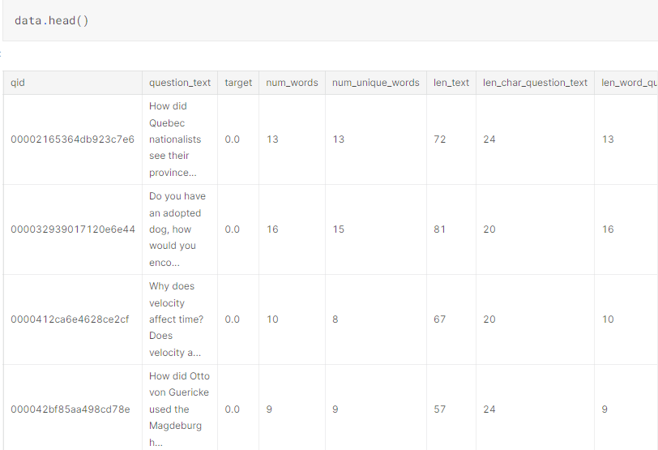
Feature engineering
Adding additional features to the raw data using domain knowledge.
These extra features help improve quality of results.

Slide 9
Modeling
Using logistic regression model from sklearn.linear_model library.
Added 8 new columns as shown in feature engineering for prediction of unseen data.
Splitting the dataset into train and test in ratio 0.8:0.2.
Parameters used in LogisticRegression(C=0.1, solver=‘sag’, max_iteration=1000)
C→ Inverse of regularization strength; must be a positive float.
Solver→ algorithm to use in the optimization problem. ‘Sag’ and ‘Saga’ are used for large datasets.
Max_iteration→ maximum number of iterations taken by the solver to converge.
Model fitting : logres.fit(X_train, y_train)
Predicting the target of unseen data.
Comparing X_test and y_test to obtain the accuracy.
Importing f1 score from sklearn.metrics.
F1 score→ 2(P * R) where P= Precision and R= Recall of the classification model.
f1_score(y_test, lr_preds, average='weighted')
y_test→ Actual label
lr_preds→ Predicted label
average='weighted'→ Calculate metrics for each label, and find their average weighted by support (the number of true instances for each label).
Displaying f1_score.

Slide 10
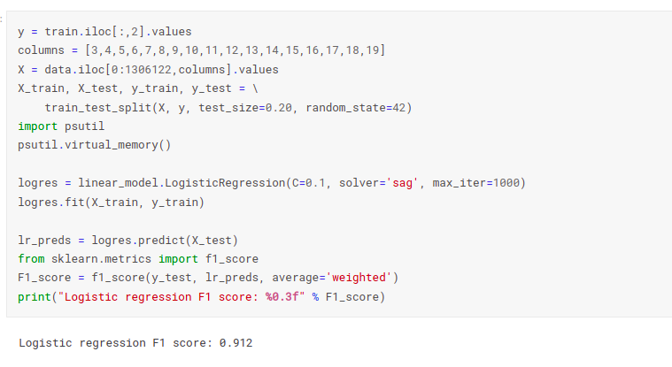
Inferences
F1 score
F1 score is the one that is calculated by combining the precision and recall measures.
f1_score= 2(P*R/(P+R)) where P is Precision and R is Recall
Precision = TP ∕ (TP+ FP)
Recall = TP ∕ (TP + FN)
Here we are getting f1-score 0.912. So we can say that model is 91% accurate on test data.

Slide 11
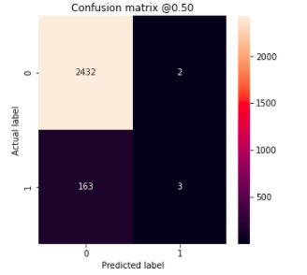
Inferences
Confusion matrix
Inference
Original dataset -1.3 M data points
Here we are taking the sample space of 13000 data points for faster computation.
The values can be interpreted as:
“true positive” for correctly predicted event values. (predicted 0, actual 0)
“false positive” for incorrectly predicted event values. (predicted 1, actual 0)
“true negative” for correctly predicted no-event values. (predicted 1, actual 1)
“false negative” for incorrectly predicted no-event values. (predicted 0, actual 1)
TP
FP
FN
TN

Slide 12
Role of each group member
Data Analysis - Sanya, Mihir, Malav, Parth
Data Preprocessing - Sanya, Mihir, Malav, Parth
Feature Engineering - Sanya, Mihir, Malav, Parth
Modeling - Sanya, Mihir, Malav, Parth
Inferences - Sanya, Mihir, Malav, Parth

Slide 13
Future work
History library is in keras and we are using sklearn so can’t extract epochs and loss for graph plotting.
Facing issues in plotting accuracy vs epochs and loss vs epochs graphs for training and testing sets.
Dividing dataset into train, validation and test and performing model selection.
Designing logistic regression function from scratch.
Deriving precision and recall score.
Looking for other ML algorithms like Naive-Bayes and SVM.

Slide 14
References
S. T. Indra, L. Wikarsa and R. Turang, "Using logistic regression method to classify tweets into the selected topics," 2016 International Conference on Advanced Computer Science and Information Systems (ICACSIS), 2016, pp. 385-390, doi: 10.1109/ICACSIS.2016.7872727.
O. Aborisade and M. Anwar, "Classification for Authorship of Tweets by Comparing Logistic Regression and Naive Bayes Classifiers," 2018 IEEE International Conference on Information Reuse and Integration (IRI), 2018, pp. 269-276, doi: 10.1109/IRI.2018.00049.
“Sklearn.linear_model.logisticregression,” scikit. [Online]. Available: https://scikit-learn.org/stable/modules/generated/sklearn.linear_model.LogisticRegression.html. [Accessed: 20-Mar-2022].
“Precision-recall,” scikit. [Online]. Available: https://scikit-learn.org/stable/auto_examples/model_selection/plot_precision_recall.html. [Accessed: 20-Mar-2022].
Y. Liu, J. Niu, Q. Zhao, J. Lv and S. Ma, "A Novel Text Classification Method for Emergency Event Detection on Social Media," 2018 IEEE SmartWorld, Ubiquitous Intelligence & Computing, Advanced & Trusted Computing, Scalable Computing & Communications, Cloud & Big Data Computing, Internet of People and Smart City Innovation (SmartWorld/SCALCOM/UIC/ATC/CBDCom/IOP/SCI), 2018, pp. 1106-1111, doi: 10.1109/SmartWorld.2018.00192.

